Slide 1
WELCOME TO THE
RESPECT CAMPAIGN

Slide 2
Respect Campaign
On average, thousands of referees quit soccer every year because of the abuse they receive from players and from the sidelines. Lots of children also give up because of the attitude and actions of over-enthusiastic and pushy parents.

Slide 3
Respect Campaign
In response, the USRC’s Respect program provides a series of tools for leagues, clubs, coaches, referees, players and parents from “grassroots to elite soccer” at all levels in
which to play and enjoy the game.
These tools include agreed upon codes of conduct, in-service training for referees and coaches, including how to ensure team captains work in cooperation with referees to manage player behavior. Respect “club packs” will also be utilized

Slide 4
Respect Campaign
The English Football Association launched a Respect Campaign in 2008, with positive results.
We aim to follow their example in the US. The USRC began promoting this concept with FA approval in 2010.
The US Soccer Federation followed with its Respect Campaign in 2011.
We want to support and encourage this effort. Join us and be part of history.

Slide 5
Respect Campaign
We invite you to become part of the "Respect Campaign" and help us change the bad behavior that some people show on the field.
We are proud to follow the example of the FA, UEFA and US Soccer and hope that more organizations will follow.
Our goal is to reach as many people involved with soccer as we can and to promote the “Codes of Conduct” which form the basis of the Respect Campaign.

Slide 6
View this video at:
www.usrefereeconnection.com/respect/respectvideos
Are you losing it ?

Slide 7
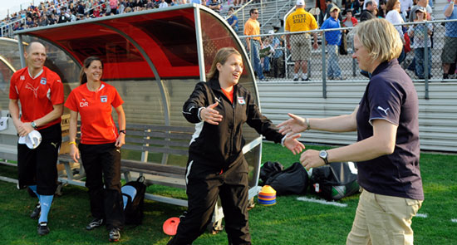
Respect Campaign
Do you know someone who behaves like the guy in this video?
Then, that person needs to learn about the “Respect Campaign”

Slide 8
So….What is Respect ?
Respect is the collective responsibility
of everyone in soccer to create a fair,
safe and enjoyable environment in
which the game can take place. It is
the behavioral code for soccer.

Slide 9
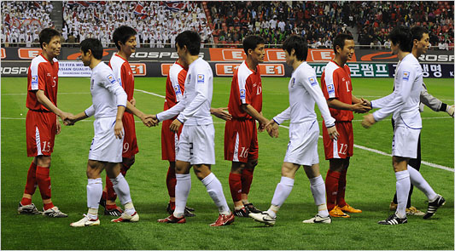
Respect is the USRC’s program to address unacceptable behavior in soccer - “on and off the field”
And we invite YOU to join us

Slide 10
INTRODUCING THE
RESPECT PROGRAM
IN YOUR LEAGUE,CLUB
ORGANIZATION,ETC.

Slide 11
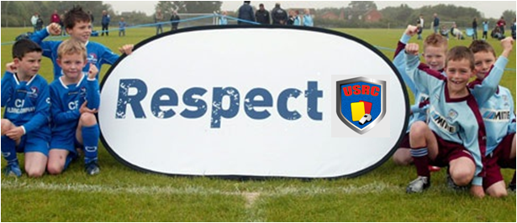
Respect Program
Codes of Conduct aren't new and are already used by some clubs and organizations. Some are successful, some are forgotten and are not acted upon. “Respect brings them to life.” How? By supporting and strengthening the Codes of Conduct with possible consequences. There is little point in having a set of rules if no action is taken if and when they're broken.

Slide 12
Respect Program
There are five Codes of Conduct, each listing possible consequences for breaking these 'promises'. The Codes are aimed at:
Young Players
Adult Players
Spectators and Parents/Guardians
Coaches, Team Managers and Club Officials
Referees
Note:
Distribute handouts
Download Codes of Conduct (pdf. Files) and Educational Materials at: www.usrefereeconnection.com/respect

Slide 13
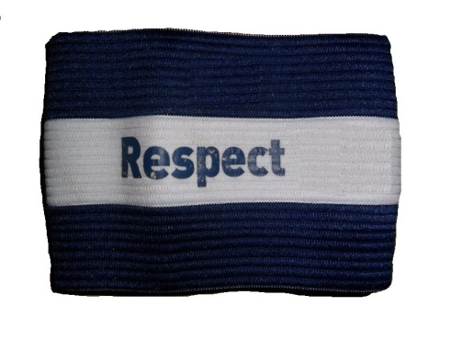
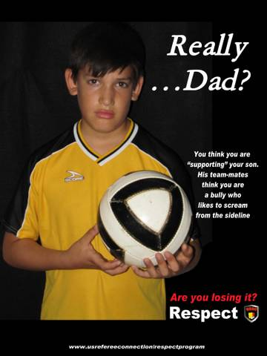
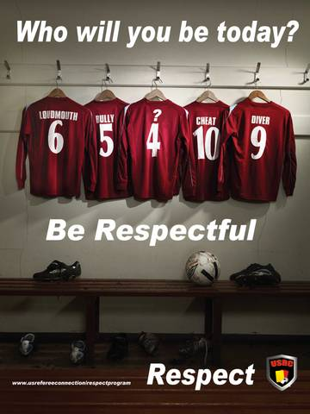
Use of visual tools
Respect armband for referees and captains
(to be worn at each game)
Posters about Respect Program
Link to the Respect Campaign website, so every member of your league/organization can be informed with the goal of signing on and becoming a “Fan” of the Respect Campaign program. www.usrefereeconnection.com/respect

Slide 14
The RESPECT Code
RESPECT
eferees are in charge of the game
ncourage your team-mates
tand up against bad behavior
lay fairly
njoy the game
ommunicate with respect
hink positive
Notes:
Put a title on this maybe The RESPECT motto

Slide 15
JOIN THE
RESPECT CAMPAIGN
www.usrefereeconnection.com/respect
www.facebook.com/pages/US-Respect-Campaign/137208289686892

